Slide 1
From Decision Tree to Random Forest

Slide 2
CART
Classification and Regression Tree
This Decision Tree can handle numeric input AND output

Slide 3
Trees and Rules
Goal: Classify or predict an outcome based on a set of predictors
The output is a set of rules
Example:
Goal: classify a record as “will accept credit card offer” or “will not accept”
Rule might be “IF (Income > 92.5) AND (Education < 1.5) AND (Family <= 2.5) THEN Class = 0 (nonacceptor)
Also called CART, Decision Trees, or just Trees
Rules are represented by tree diagrams

Slide 4
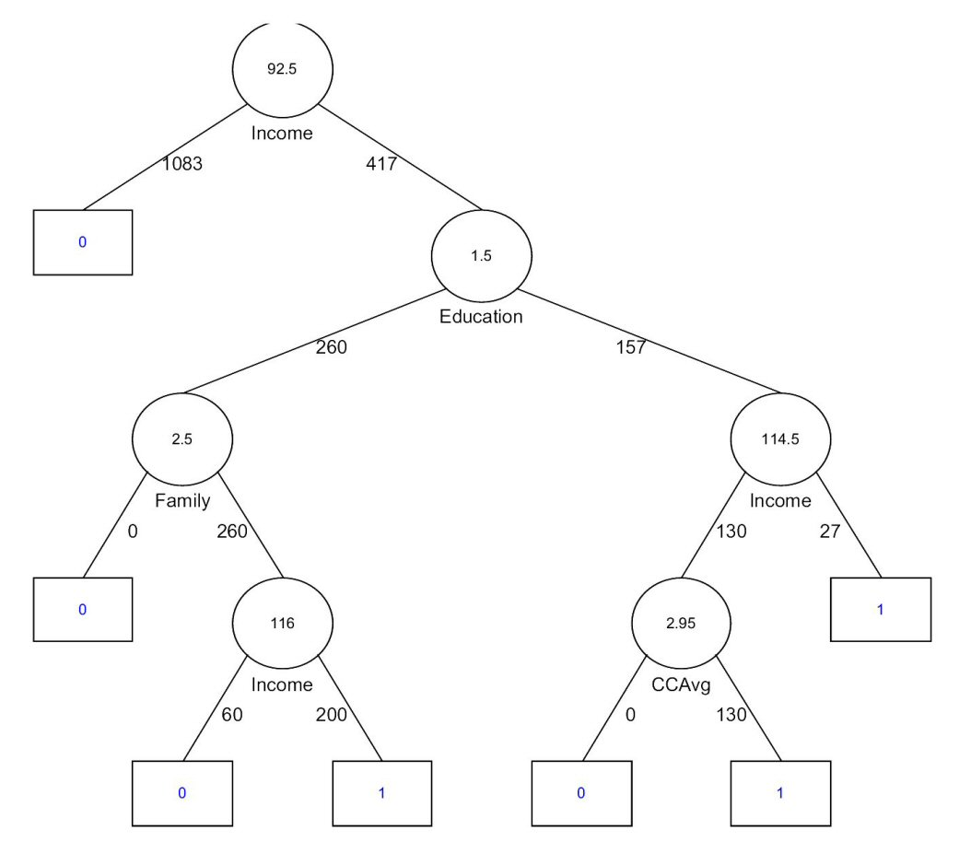

Slide 5
Key Ideas
Recursive partitioning: Repeatedly split the records into two parts so as to achieve maximum homogeneity within the new parts
Pruning the tree: Simplify the tree by pruning peripheral branches to avoid overfitting

Slide 6
Recursive Partitioning

Slide 7
Recursive Partitioning Steps
Pick one of the predictor variables, x_{i}
Pick a value of x_{i,} say s_{i}, that divides the training data into two (not necessarily equal) portions
Measure how “pure” or homogeneous each of the resulting portions are
“Pure” = containing records of mostly one class
Algorithm tries different values of x_{i,} and s_{i} to maximize purity in initial split
After you get a “maximum purity” split, repeat the process for a second split, and so on

Slide 8
Example: Riding Mowers
Goal: Classify 24 households as owning or not owning riding mowers
Predictors = Income, Lot Size

Slide 10
How to split
Order records according to one variable, say lot size
Find midpoints between successive values
E.g. first midpoint is 14.4 (halfway between 14.0 and 14.8)
Divide records into those with lotsize > 14.4 and those < 14.4
After evaluating that split, try the next one, which is 15.4 (halfway between 14.8 and 16.0)

Slide 11
Note: Categorical Variables
Examine all possible ways in which the categories can be split.
E.g., categories A, B, C can be split 3 ways
{A} and {B, C}
{B} and {A, C}
{C} and {A, B}
With many categories, # of splits becomes huge
XLMiner supports only binary categorical variables

Slide 12
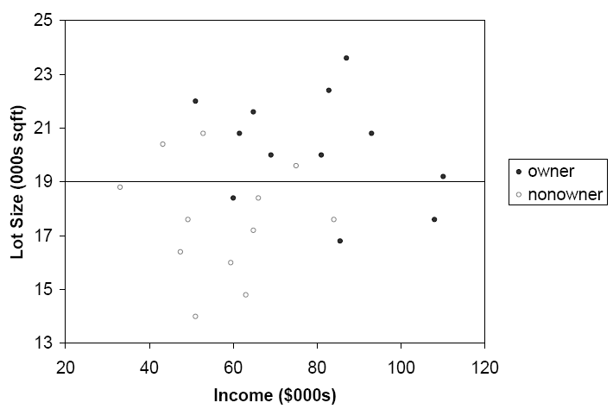
The first split: Lot Size = 19,000

Slide 13
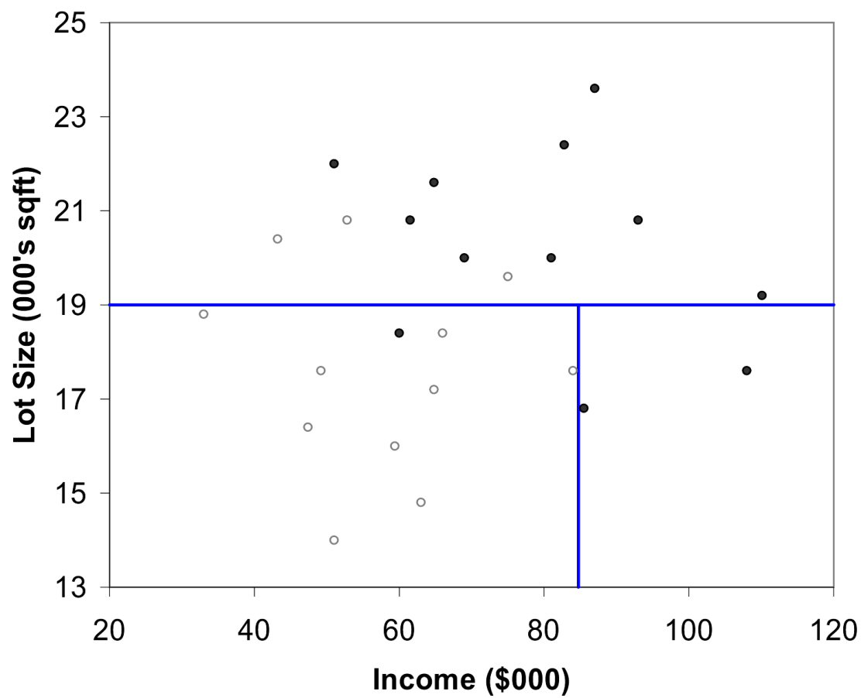
Second Split: Income = $84,000

Slide 14
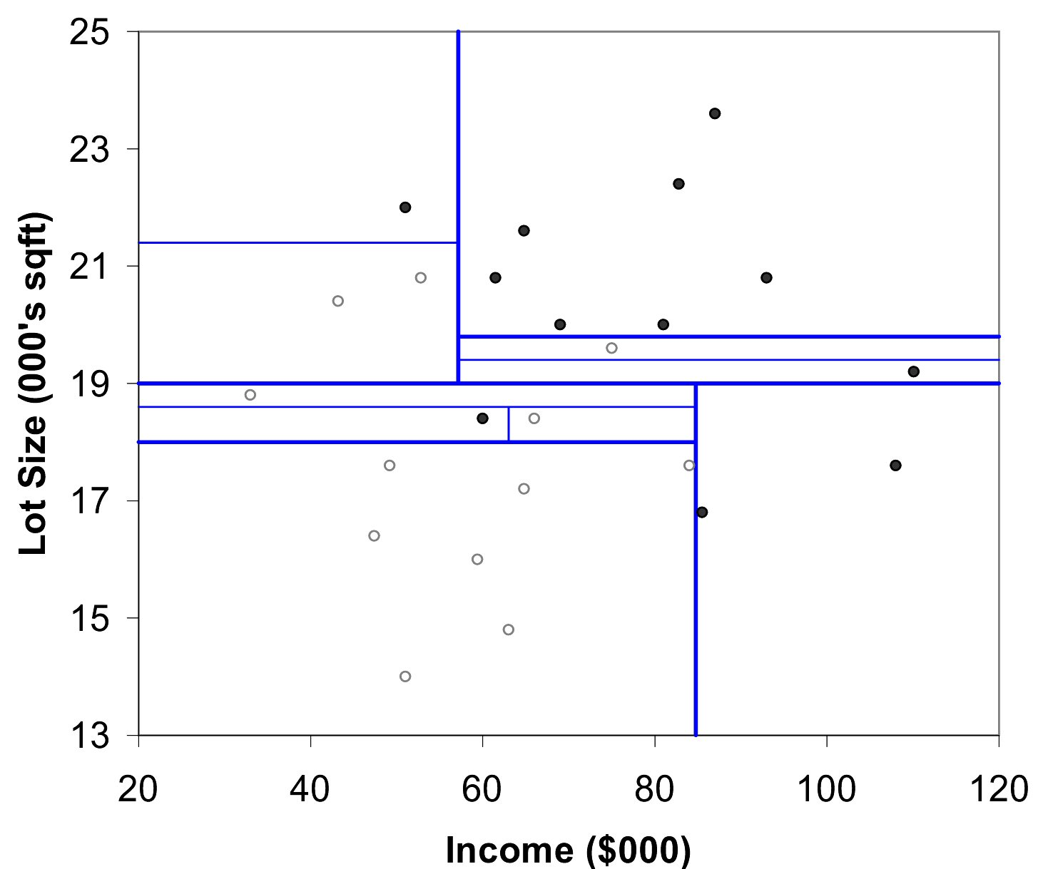
After All Splits

Slide 15
Measuring Impurity

Slide 16
Gini Index
Gini Index for rectangle A containing m records
p = proportion of cases in rectangle A that belong to class k
I(A) = 0 when all cases belong to same class
Max value when all classes are equally represented (= 0.50 in binary case)
Note: XLMiner uses a variant called “delta splitting rule”

Slide 17
Entropy
p = proportion of cases (out of m) in rectangle A that belong to class k
Entropy ranges between 0 (most pure) and log₂(m) (equal representation of classes)

Slide 18
Impurity and Recursive Partitioning
Obtain overall impurity measure (weighted avg. of individual rectangles)
At each successive stage, compare this measure across all possible splits in all variables
Choose the split that reduces impurity the most
Chosen split points become nodes on the tree

Slide 19
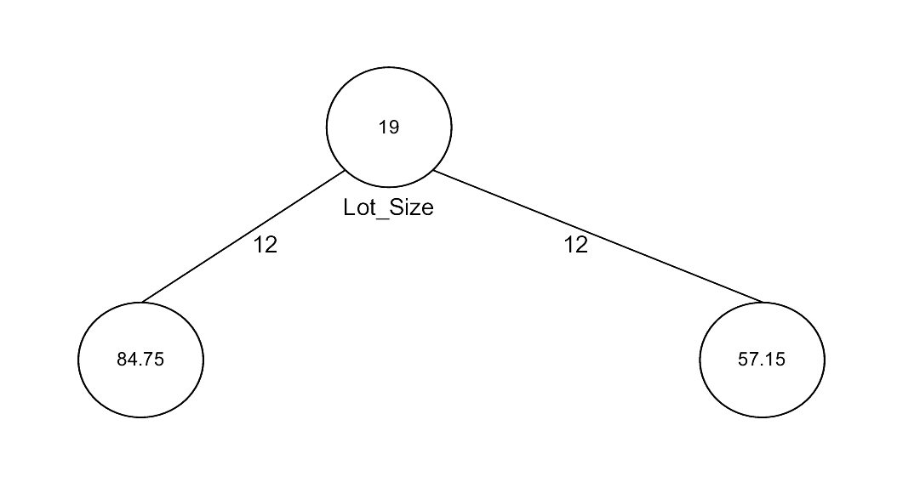
First Split – The Tree

Slide 20
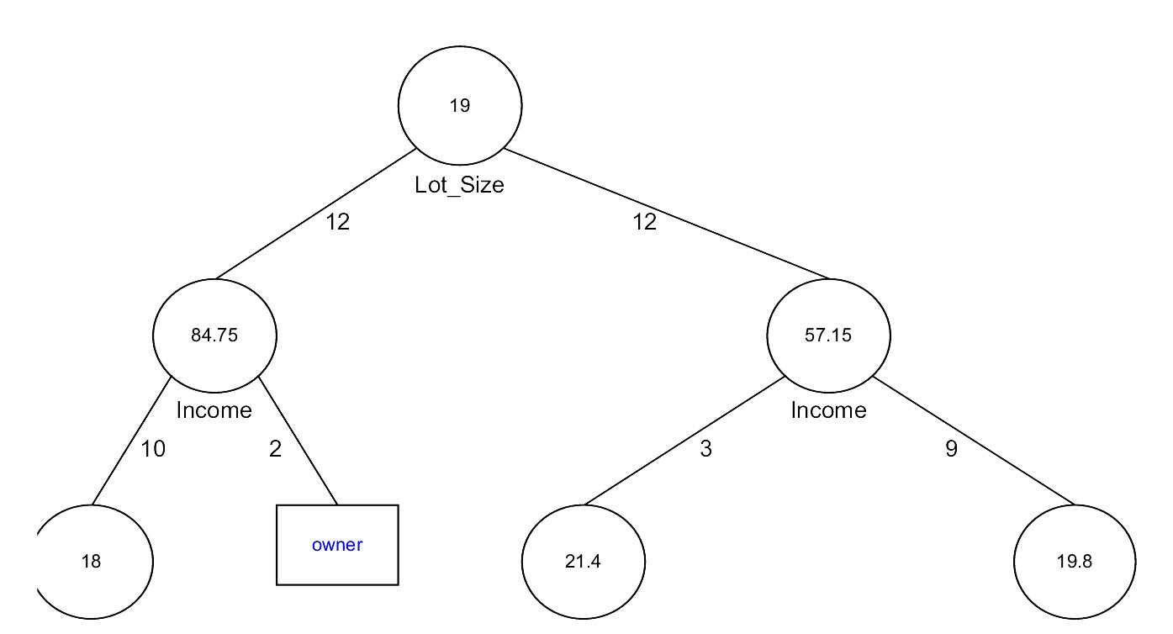
Tree after three splits

Slide 21
Tree Structure
Split points become nodes on tree (circles with split value in center)
Rectangles represent “leaves” (terminal points, no further splits, classification value noted)
Numbers on lines between nodes indicate # cases
Read down tree to derive rule
E.g., If lot size < 19, and if income > 84.75, then class = “owner”

Slide 22
Determining Leaf Node Label
Each leaf node label is determined by “voting” of the records within it, and by the cutoff value
Records within each leaf node are from the training data
Default cutoff=0.5 means that the leaf node’s label is the majority class.
Cutoff = 0.75: requires majority of 75% or more “1” records in the leaf to label it a “1” node

Slide 23
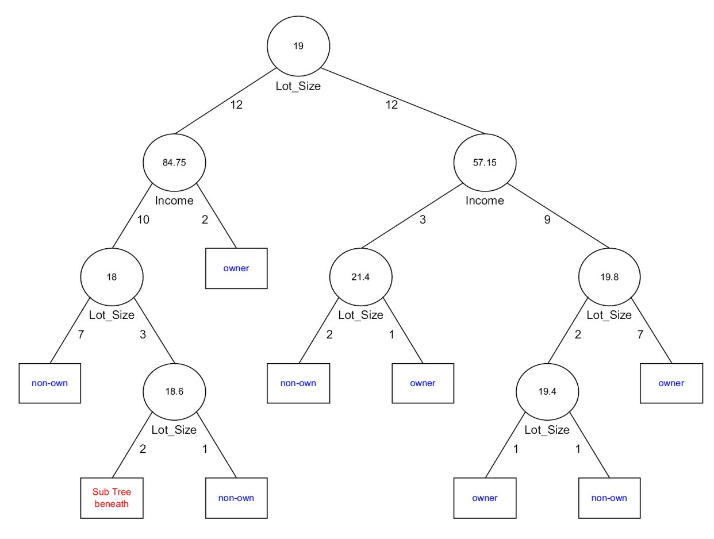
Tree after all splits

Slide 24
The Overfitting Problem

Slide 25
Stopping Tree Growth
Natural end of process is 100% purity in each leaf
This overfits the data, which end up fitting noise in the data
Overfitting leads to low predictive accuracy of new data
Past a certain point, the error rate for the validation data starts to increase

Slide 26
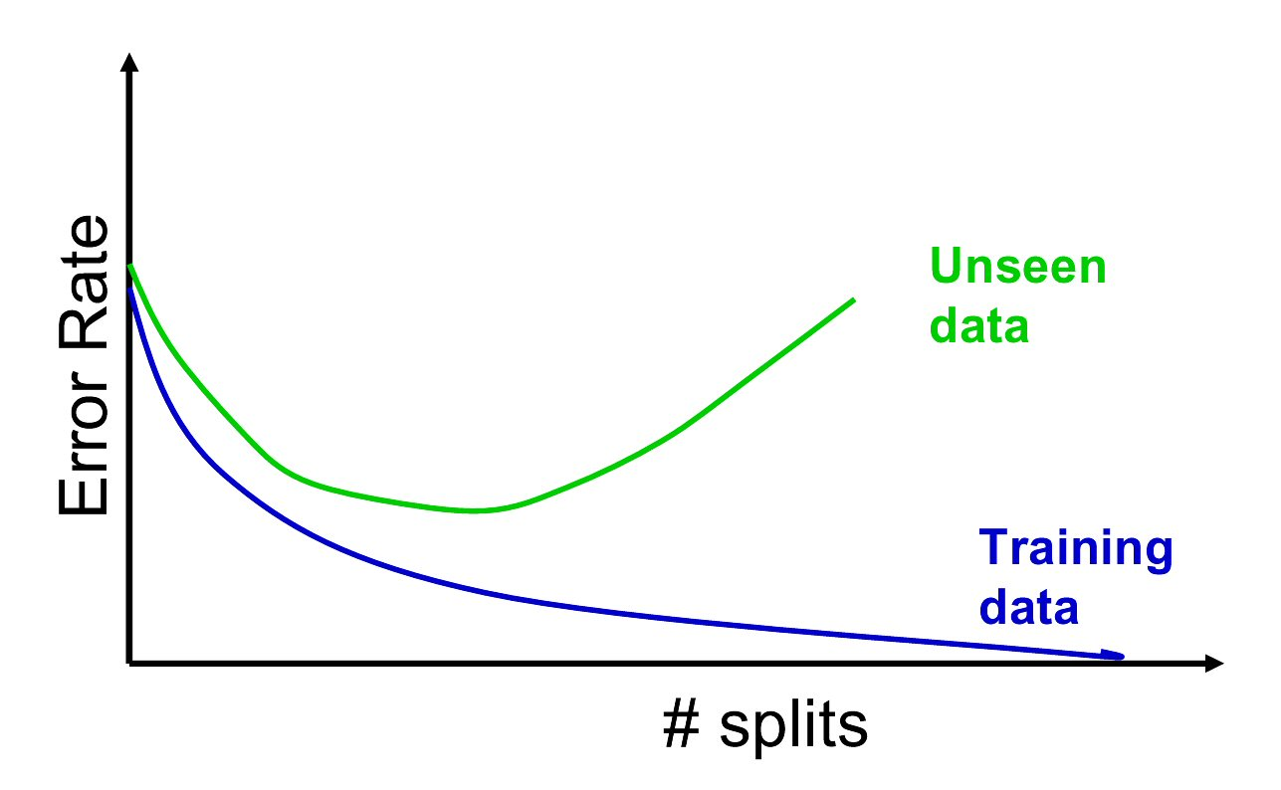
Full Tree Error Rate

Slide 27
CHAID
CHAID, older than CART, uses chi-square statistical test to limit tree growth
Splitting stops when purity improvement is not statistically significant

Slide 28
Pruning
CART lets tree grow to full extent, then prunes it back
Idea is to find that point at which the validation error begins to rise
Generate successively smaller trees by pruning leaves
At each pruning stage, multiple trees are possible
Use cost complexity to choose the best tree at that stage

Slide 29
Cost Complexity
CC(T) = Err(T) + α L(T)
CC(T) = cost complexity of a tree
Err(T) = proportion of misclassified records
α = penalty factor attached to tree size (set by user)
Among trees of given size, choose the one with lowest CC
Do this for each size of tree

Slide 30
Using Validation Error to Prune
Pruning process yields a set of trees of different sizes and associated error rates
Two trees of interest:
Minimum error tree
Has lowest error rate on validation data
Best pruned tree
Smallest tree within one std. error of min. error
This adds a bonus for simplicity/parsimony

Slide 31
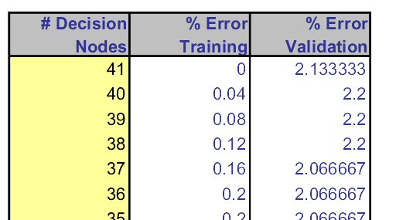
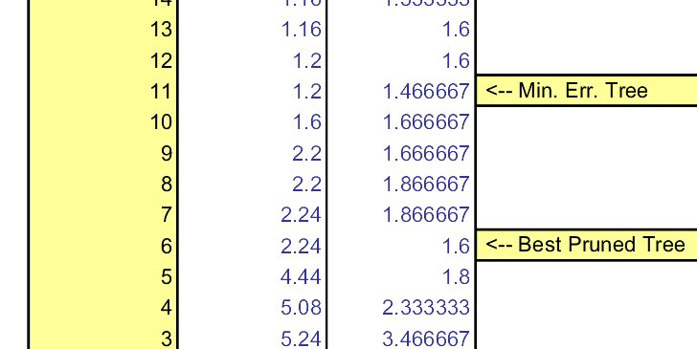
Error rates on pruned trees

Slide 32
Regression Trees

Slide 33
Regression Trees for Prediction
Used with continuous outcome variable
Procedure similar to classification tree
Many splits attempted, choose the one that minimizes impurity

Slide 34
Differences from CT
Prediction is computed as the average of numerical target variable in the rectangle (in CT it is majority vote)
Impurity measured by sum of squared deviations from leaf mean
Performance measured by RMSE (root mean squared error)

Slide 35
Advantages of trees
Easy to use, understand
Produce rules that are easy to interpret & implement
Variable selection & reduction is automatic
Do not require the assumptions of statistical models
Can work without extensive handling of missing data

Slide 36
Disadvantages
May not perform well where there is structure in the data that is not well captured by horizontal or vertical splits
Since the process deals with one variable at a time, no way to capture interactions between variables

Slide 37
Summary
Classification and Regression Trees are an easily understandable and transparent method for predicting or classifying new records
A tree is a graphical representation of a set of rules
Trees must be pruned to avoid over-fitting of the training data
As trees do not make any assumptions about the data structure, they usually require large samples

Slide 38

From Decision tree to Random Forrest
To handle decision tree’s generalization capability we may use a new approach
Power of the crowds

Slide 39
Definition
A single decision tree does not perform well
But, it is super fast, what if we learn multiple trees?
Random forest (or random forests) is an ensemble classifier that consists of many decision trees and outputs the class that is the mode of the class's output by individual trees.
The term came from random decision forests that was first proposed by Tin Kam Ho of Bell Labs in 1995.
The method combines Breiman's "bagging" idea and the random selection of features.

Slide 40
Decision trees
Decision trees are individual learners that are combined. They are one of the most popular learning methods commonly used for data exploration.
One type of decision tree is called CART… classification and regression tree.
CART … greedy, top-down binary, recursive partitioning, that divides feature space into sets of disjoint rectangular regions.
Regions should be pure wrt response variable
Simple model is fit in each region – majority vote for classification, constant value for regression.

Slide 41
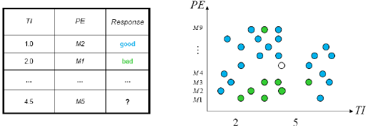
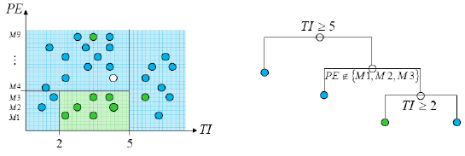
Decision tress involve greedy, recursive partitioning.
Simple dataset with two predictors
Greedy, recursive partitioning along TI and PE

Slide 42
Algorithm
Each tree is constructed using the following algorithm:
Let the number of training cases be N, and the number of variables in the classifier be M.
We are told the number m of input variables to be used to determine the decision at a node of the tree; m should be much less than M.
Choose a training set for this tree by choosing n times with replacement from all N available training cases (i.e. take a bootstrap sample). Use the rest of the cases to estimate the error of the tree, by predicting their classes.
For each node of the tree, randomly choose m variables on which to base the decision at that node. Calculate the best split based on these m variables in the training set.
Each tree is fully grown and not pruned (as may be done in constructing a normal tree classifier).
For prediction a new sample is pushed down the tree. It is assigned the label of the training sample in the terminal node it ends up in. This procedure is iterated over all trees in the ensemble, and the average vote of all trees is reported as random forest prediction.

Slide 43
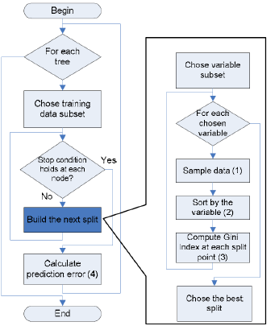
Algorithm flow chart
For computer scientists:

Slide 44
Random Forest – practical consideration
Splits are chosen according to a purity measure:
E.g. squared error (regression), Gini index or devinace (classification)
How to select N?
Build trees until the error no longer decreases
How to select M?
Try to recommend defaults, half of them and twice of them and pick the best.

Slide 45
Features and Advantages
The advantages of random forest are:
It is one of the most accurate learning algorithms available. For many data sets, it produces a highly accurate classifier.
It runs efficiently on large databases.
It can handle thousands of input variables without variable deletion.
It gives estimates of what variables are important in the classification.
It generates an internal unbiased estimate of the generalization error as the forest building progresses.
It has an effective method for estimating missing data and maintains accuracy when a large proportion of the data are missing.

Slide 46
Features and Advantages
It has methods for balancing error in class population unbalanced data sets.
Generated forests can be saved for future use on other data.
Prototypes are computed that give information about the relation between the variables and the classification.
It computes proximities between pairs of cases that can be used in clustering, locating outliers, or (by scaling) give interesting views of the data.
The capabilities of the above can be extended to unlabeled data, leading to unsupervised clustering, data views and outlier detection.
It offers an experimental method for detecting variable interactions.

Slide 47
Disadvantages
Random forests have been observed to overfit for some datasets with noisy classification/regression tasks.
For data including categorical variables with different number of levels, random forests are biased in favor of those attributes with more levels. Therefore, the variable importance scores from random forest are not reliable for this type of data.

Slide 48
RM - Additional information
Estimating the test error:
While growing forest, estimate test error from training samples
For each tree grown, 33-36% of samples are not selected in bootstrap, called out of bootstrap (OOB) samples
Using OOB samples as input to the corresponding tree, predictions are made as if they were novel test samples
Through book-keeping, majority vote (classification), average (regression) is computed for all OOB samples from all trees.
Such estimated test error is very accurate in practice, with reasonable N

Slide 49
RM - Additional information
Estimating the importance of each predictor:
Denote by ê the OOB estimate of the loss when using original training set, D.
For each predictor xp where p∈{1,..,k}
Randomly permute pth predictor to generate a new set of samples D' ={(y1,x'1),…,(yN,x'N)}
Compute OOB estimate êk of prediction error with the new samples
A measure of importance of predictor xp is êk – ê, the increase in error due to random perturbation of pth predictor

Slide 50
Conclusions & summary:
Fast fast fast!
RF is fast to build. Even faster to predict!
Practically speaking, not requiring cross-validation alone for model selection significantly speeds training by 10x-100x or more.
Fully parallelizable … to go even faster!
Automatic predictor selection from large number of candidates
Resistance to over training
Ability to handle data without preprocessing
data does not need to be rescaled, transformed, or modified
resistant to outliers
automatic handling of missing values
Cluster identification can be used to generate tree-based clusters through sample proximity

Slide 51
Want to know more?
https://web.stanford.edu/~hastie/ElemStatLearn/printings/ESLII_print12.pdf

